Slide 1
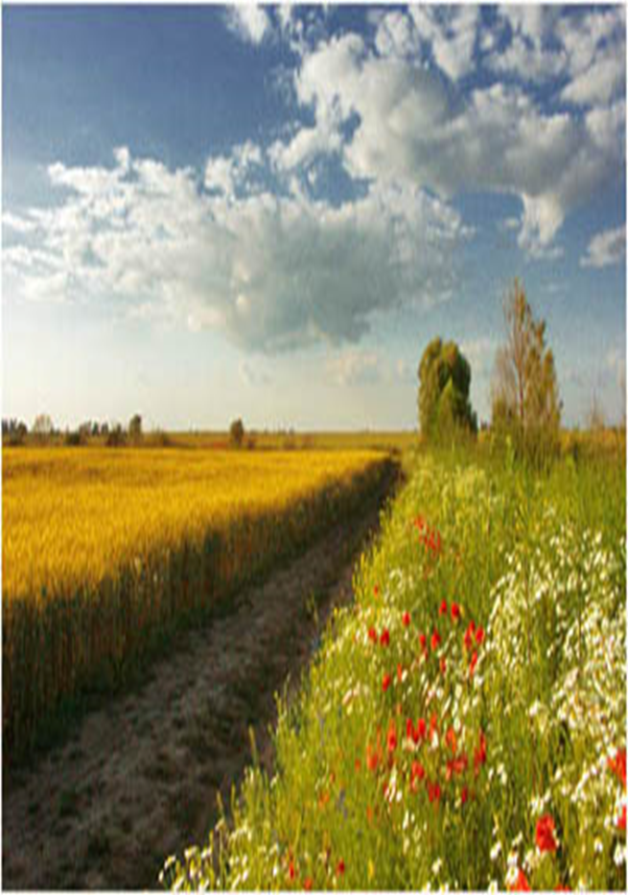
The current situation and priorities for the development of agriculture and rural areas in Ukraine
Deputy Minister of Agrarian Policy and Food of Ukraine
Vitaliy Holovnia

Slide 2
The state of the agricultural industry before a full-scale war
The increase in the production of agricultural products, in 2021 the increase was 16.4% compared to 2020
The share in GDP was 10%, and together with the processing of agricultural products - 16%
Leadership in international trade in sunflower oil (first place in the world), rapeseed and barley (third and fourth places, respectively)
Trade in agricultural products and foodstuffs brought Ukraine about 22 billion dollars annually. USA and accounted for 41% of all exports
2

Slide 3
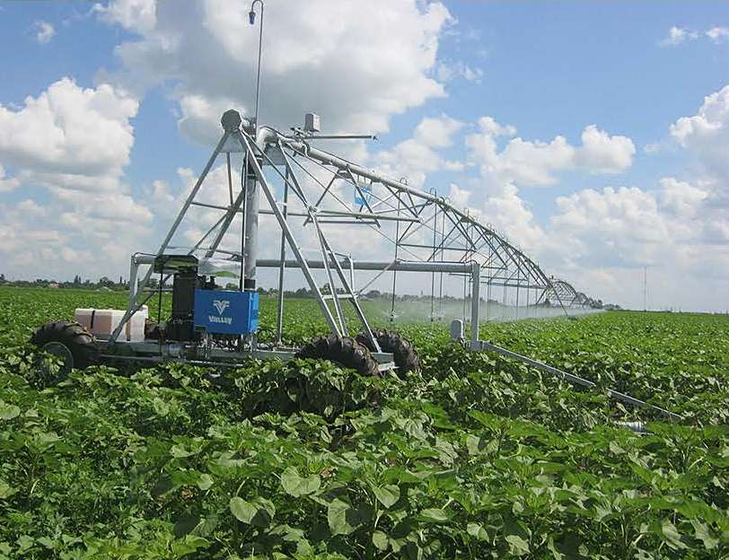
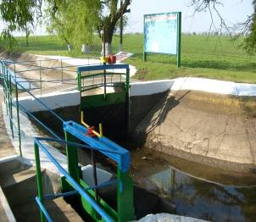
Overview of land reclamation in Ukraine
5.48 million hectares of reclaimed land are accounted for, including 2.17 million hectares of irrigated and 3.3 million hectares of drained land
In 2021, about 600,000 hectares of agricultural land were actually irrigated, and bilateral regulation was carried out on an area of about 250,000 hectares
The existing water management and melioration infrastructure is sufficient for the intake and supply of water for irrigation of at least 1.8 million hectares, and the drainage of excess water on an area of more than 1 million hectares..
3

Slide 4
The main challenges that were recognized before the start of the war
Climate change, deterioration of the country's water supply
Transition to a green economy and "good" agricultural practices in accordance with EU standards
Development of the land market and attraction of investments in restoration of irrigation and drainage, development of rural areas
Implementation of the Irrigation and Drainage Strategy until 2030: implementation of institutional reform
4

Slide 5
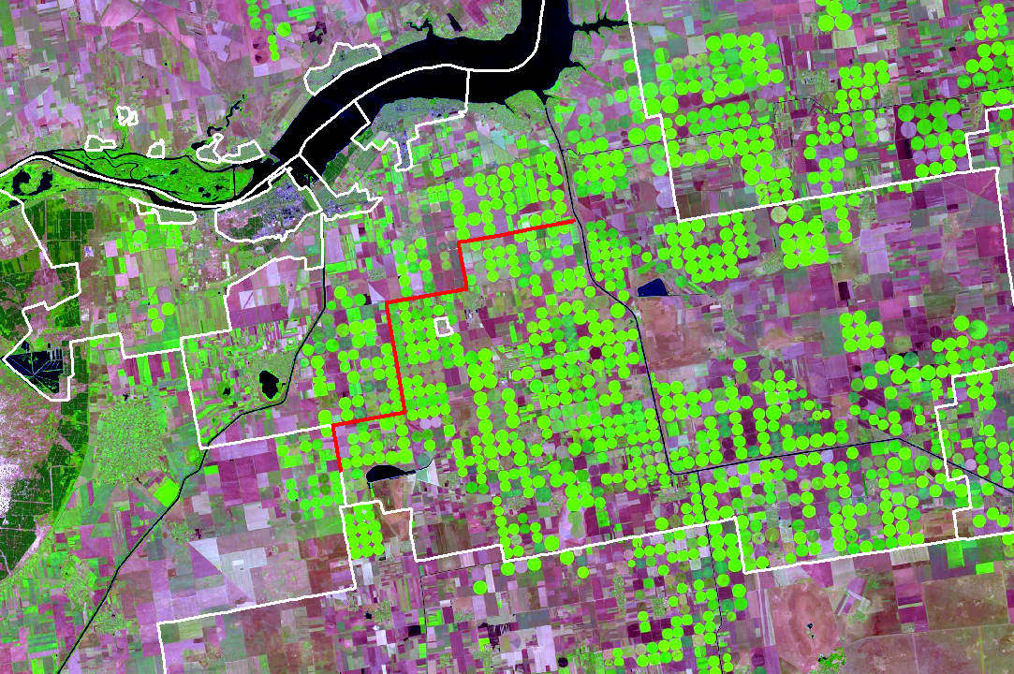
Основні проблеми галузі водного господарства та меліорації земель
Незадовільний стан використання наявного потенціалу зрошення та дренажу, зношеність інженерної інфраструктури – 70%
Дефіцит природного вологозабезпечення на більш ніж 2/3 території України, його збільшення внаслідок кліматичних змін
Невизначеність правового статусу меліоративних систем і права власності на них
Відсутність фінансової спроможності сільгосптоваровиробників у відновленні інженерної інфраструктури
5

Slide 6
Policy priorities
Restoration of exports to ensure food security in the world, support of domestic currency reserves, stable hryvnia exchange rate.
Agricultural logistics and storage of agricultural products
Restoration and development of land reclamation
Attracting investments in the agro-industrial complex, in particular in the development of agricultural infrastructure and rural areas
Restoration of the fishing industry and sustainable use of aquatic living resources
Support of agriculture and agricultural production
Implementation of EU legislation and international cooperation
6

Slide 7
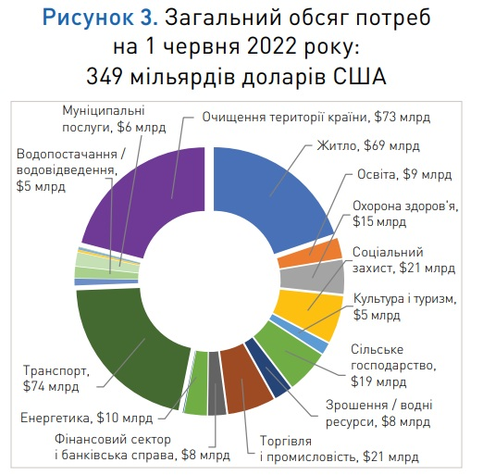
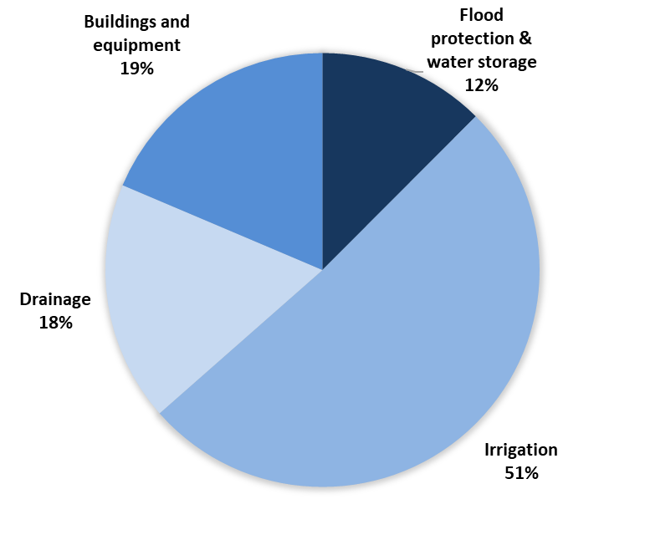
Losses and needs for restoration of water management infrastructure and irrigation (World Bank report)
Damages in the irrigation, drainage and water management sector are estimated at US$0.2 billion
The total needs for the reconstruction and restoration of the state water management infrastructure amount to 7.5 billion US dollars, which provides for the reconstruction according to the principle of "build back better" (build back better)
The most relevant are investments for the restoration of destroyed hydrotechnical structures in de-occupied territories and territories where hostilities were not carried out
7

Slide 8
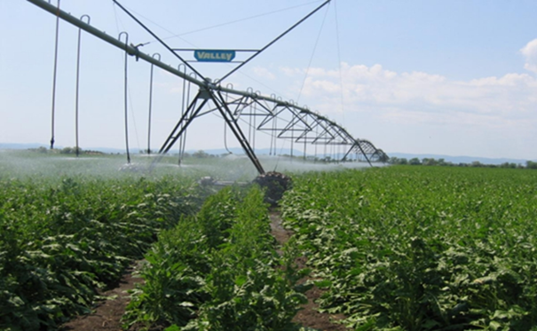
Action plan for the implementation of the reform in the field of land reclamation
Audit of the use of reclaimed land and inventory of reclamation systems
Development of legislative and regulatory acts
Institutional reform of water resources management and land reclamation
Creation of water user organizations for effective management and reliable operation of melioration systems
Implementation of investment and infrastructure projects for the restoration and development of land reclamation
8

Slide 9
Current tasks and areas of work of the Ministry for the continuation of the reform of the reclamation industry in cooperation with international partners (SB, USAID)
Continuation of damage assessment
Restoration of engineering infrastructure
Institutional reform regarding the creation of organizations of water users and operators for the management of state infrastructure
Development of production facilities
Technical assistance in the development of specific pilot projects for the restoration of objects of the engineering infrastructure of reclamation systems
Investments in the implementation of developed projects, provision of machinery and equipment for irrigation and drainage system
9

Slide 10
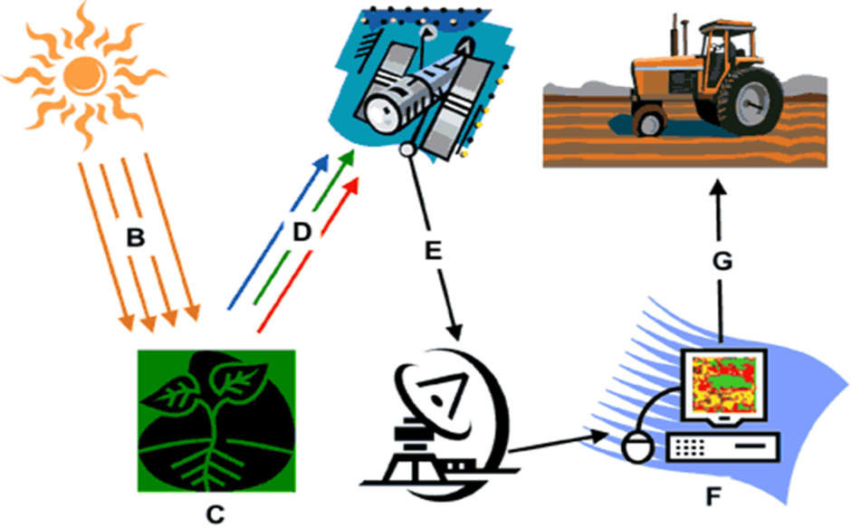
Priority areas of scientific and technical cooperation with the Netherlands (general vision)
Remote monitoring of the state of use of reclaimed land and assessment of economic and environmental damages
Justification of organizational and economic models of sustainable management of reclamation systems
Assessment of the necessary areas for the restoration and development of land reclamation, taking into account climate change and the consequences of war
Development of feasibility studies of investment projects to restore the engineering infrastructure of reclamation systems
Scientific support and implementation of pilot projects on restoration of irrigation and drainage systems

Slide 11
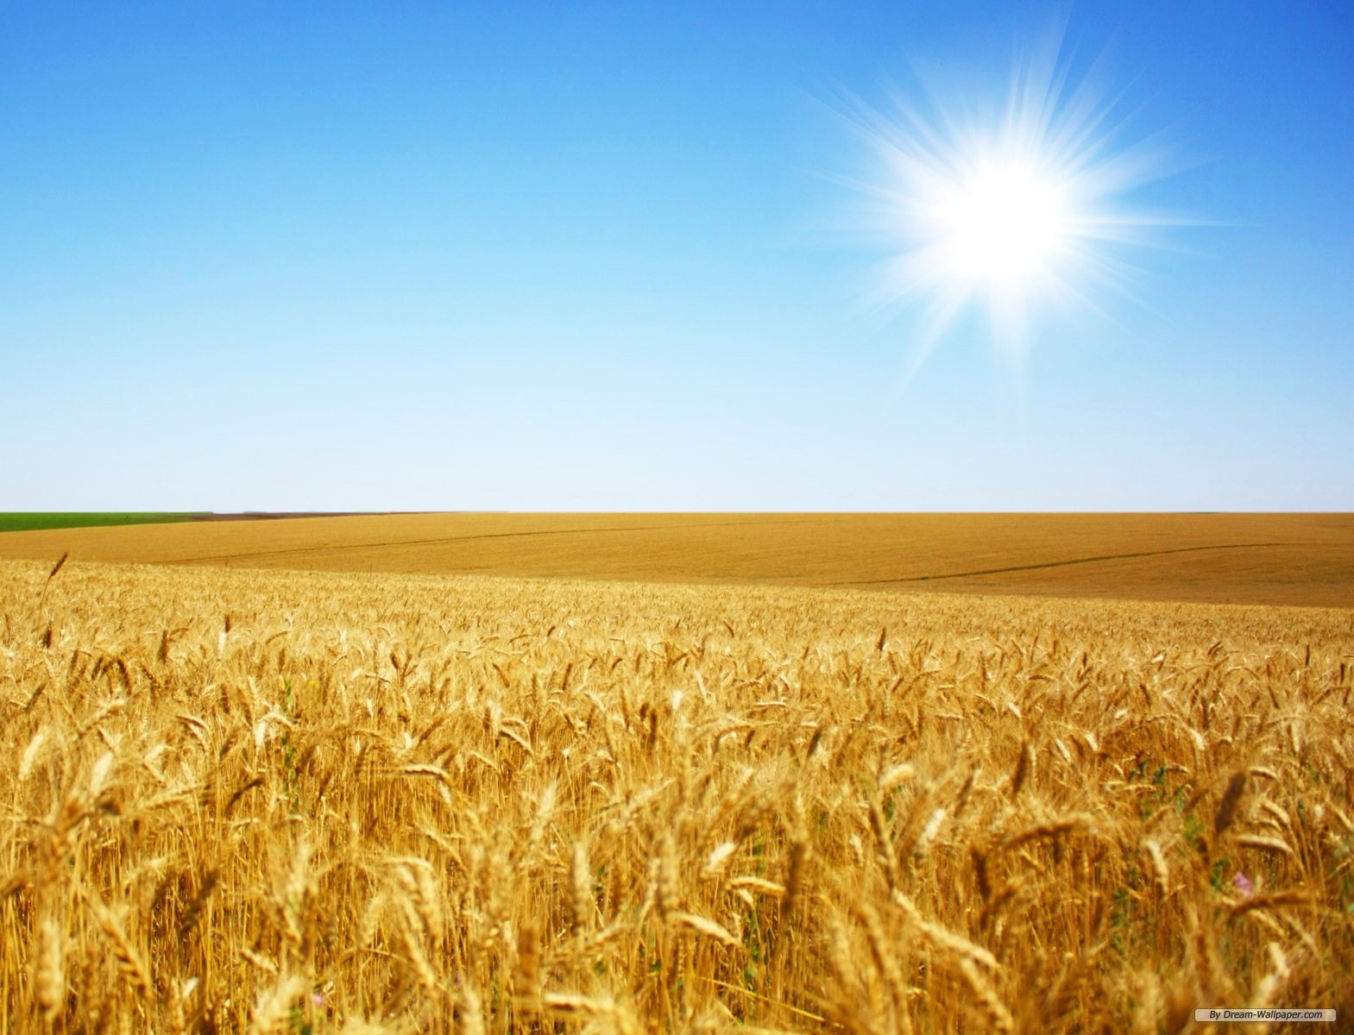
THANKS FOR YOUR ATTENTION!
11

